Slide 1
CubeSat Mid-Semester Update
Gautaman Asirwatham

Slide 2
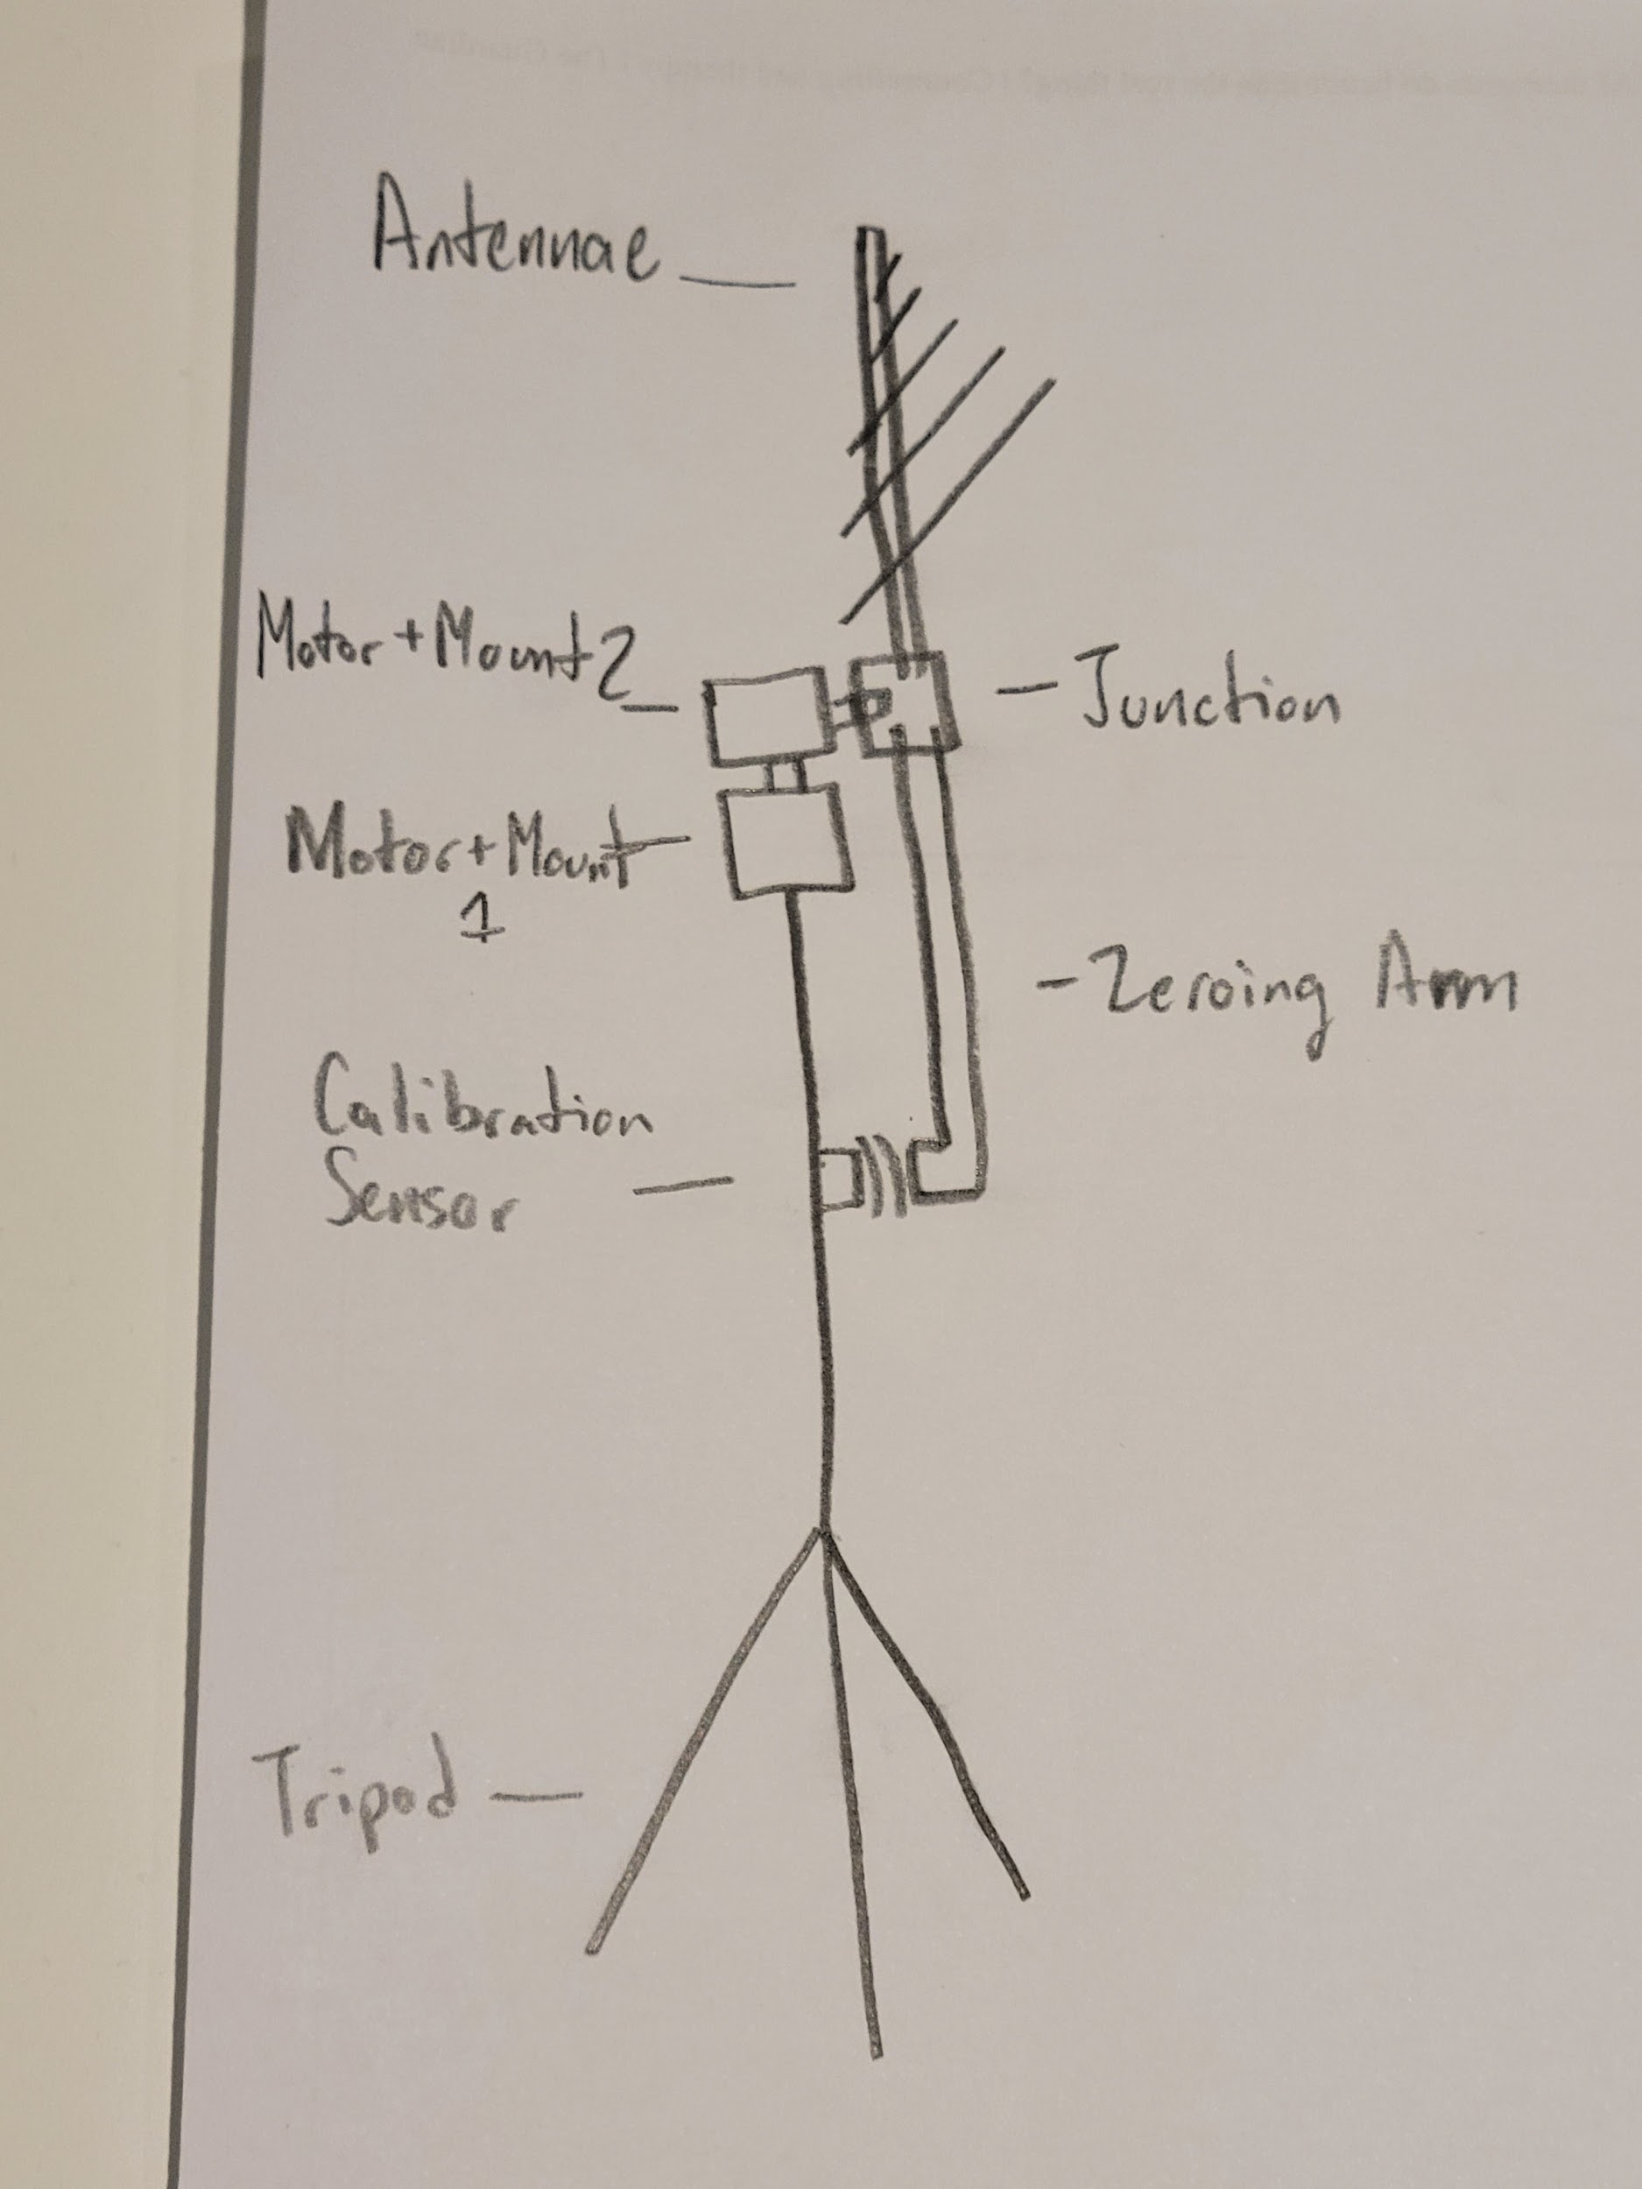
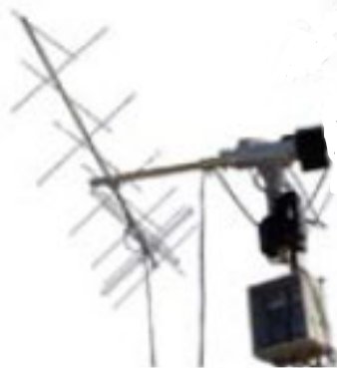
Rig Design

Slide 3
Design in Words:
A (name) tripod provides a stable base for the antennae rig. It will be fully extended to (12?) feet.
Mounted on top of the tripod is a motor mount holding a Nema 23 motor. The motor is positioned so its shaft points upwards, controlling the antenna's horizontal rotation around the base.
Next an interfacing piece, connects another Nema 23 motor mount and motor perpendicular to the first motor's shaft, controlling the antenna's vertical angle.
This motor's shaft extends to a junction piece which supports the antenna and accommodates a zeroing arm. In its fully vertical or zero position, the antenna points upwards, and the zeroing arm is strategically positioned to trigger an Omron switch along the tripod pole.
The design of the junction ensures an ample offset, allowing the antenna to rotate unobstructed in all directions—both elevation above the horizon and in a complete 360-degree azimuth circle.

Slide 4
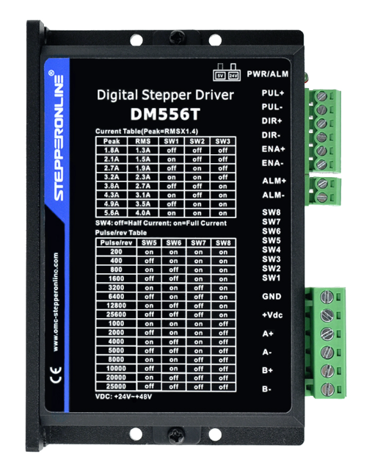
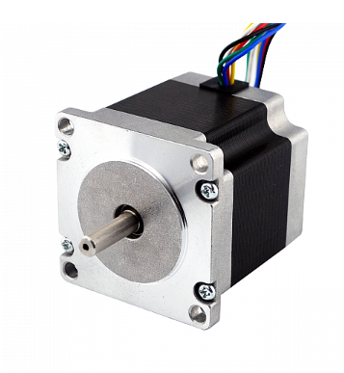
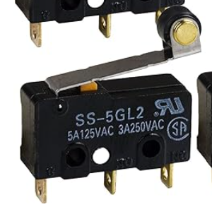
DM556T
Omron SS5GL2
Nema 23
$15.65
Holding torque = 0.6 N/m!
$20.86
Micro Stepping up to 25,000!
$9 for 5
Rolling Lever Arm!

Slide 5
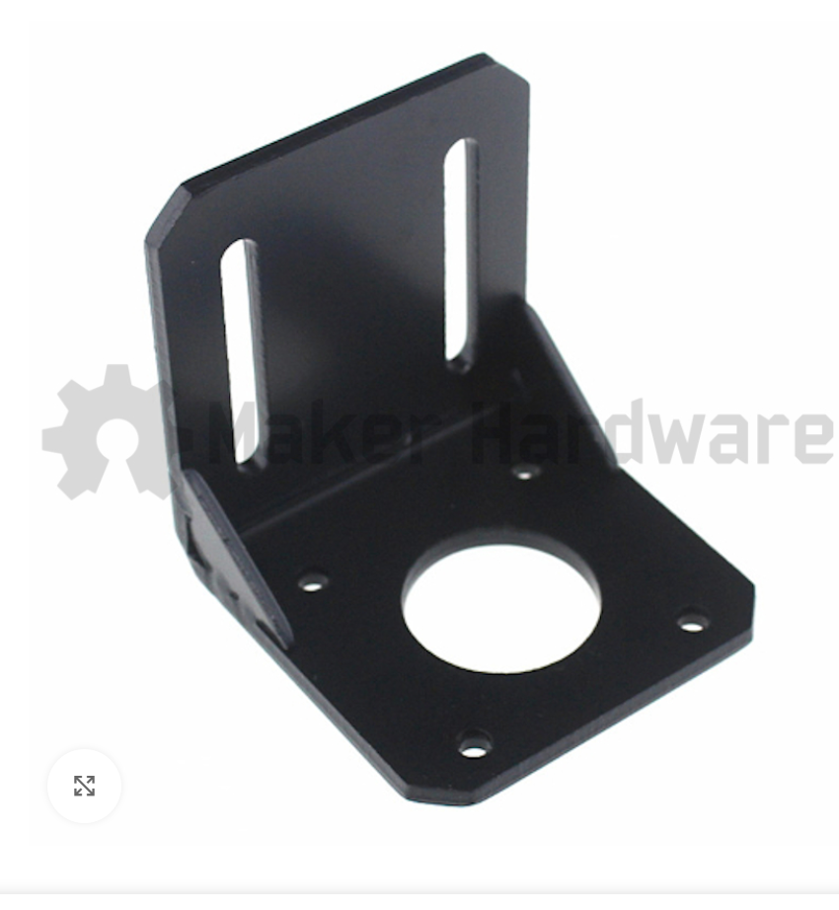
Interfacing / Design
Motor mounts specifically for the Nema 23 are available for 4$
I want to find high precision parts to buy like these where possible but:
May need to design an adapter plate for connecting the tripod to the motor mount
May need to design a bracket or plate for connecting the motor mounts to each other
May need to design the junction between the elevation motor, antennae, and zeroing arm

Slide 6
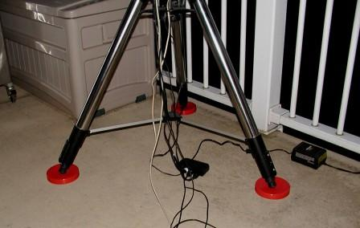
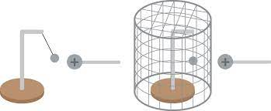
Other Potential Parts
The rig may not be stable and require a base
The motors may create electrical interference and require insulation

Slide 7
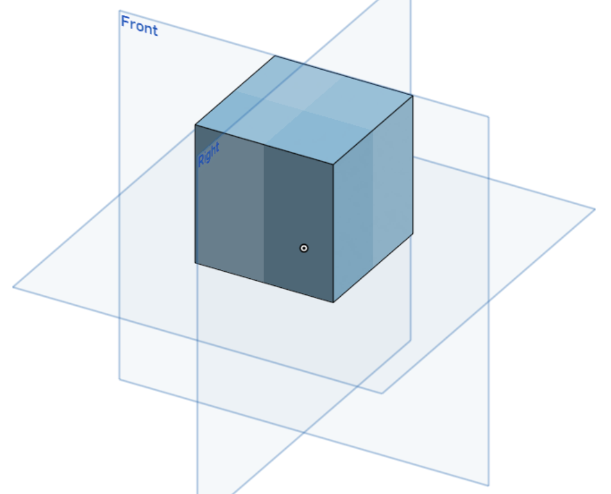
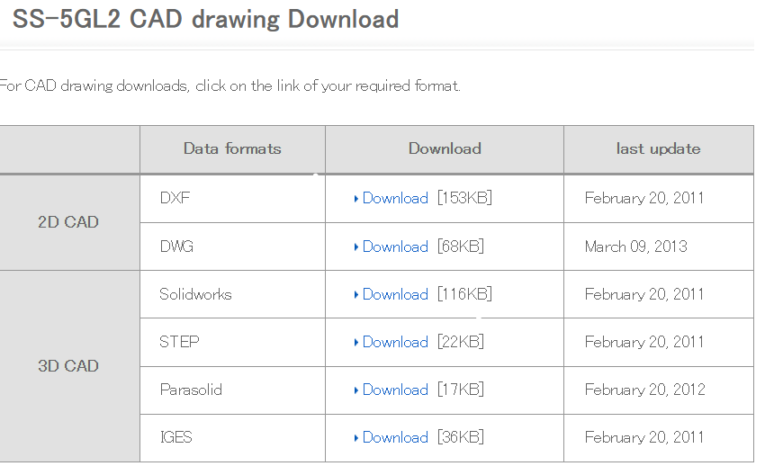
CAD
OnShape (WIP)

Slide 8
Other Setup Elements
Power
Controller
Need to decide according to the ground station requirements

Slide 9
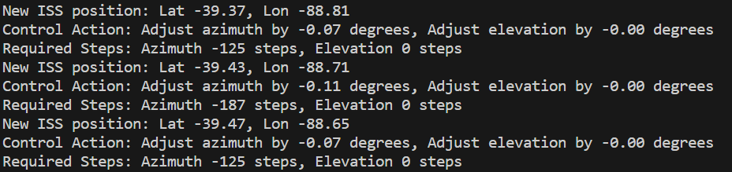
Controls

